Slide 1


Untangling ageing and age cohort effects in auto use and active transportation Mark Bradley

Slide 2


What is the problem?
Most travel demand models assume that travel behavior in a given context (the model coefficients) will remain constant into the future >>>
According to most models, in 20-30 years, all else equal…
people in my generation will behave the same as people in my parents’ generation are behaving now.
people in my children’s generation will behave the same as people in my generation are behaving now.

Slide 3
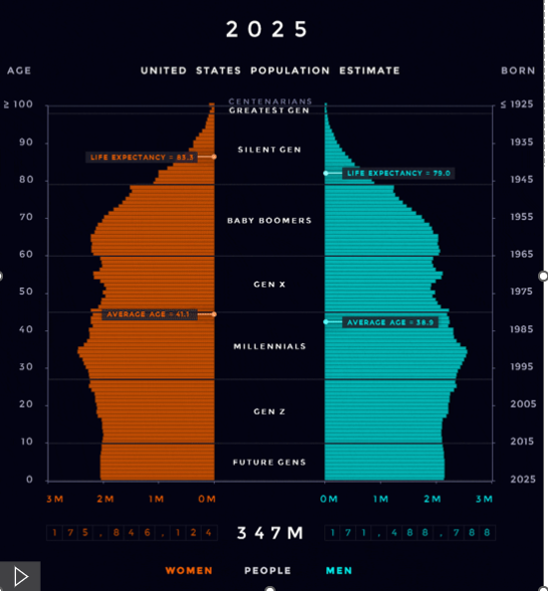
Source: https://www.visualcapitalist.com/us-population-pyramid-1980-2050/

Slide 4
How are the generations different right now?
OBJECTIVE / USUALLY OBSERVABLE IN DATA
Age
Gender
Household lifecycle
Work/school status
Income
Race/ethnicity
Vehicle availability
etc…
SUBJECTIVE / RARELY OBSERVABLE IN DATA
Past travel experiences
Developed travel habits
Attitudes and habits related to health, exercise
Attitudes and behavior related to the environment
Attitudes toward & use of new technologies
Participation in the “shared economy”

Slide 5
To separate the effects of ageing versus generational differences, we need consistent longitudinal data over a long period
EXAMPLE: First presented at the “Zephyr Panel on Behavior Dynamics: The Future Accelerated” in December 2020
Reason: An update of the IMPACTS 2050 model developed for NCHRP Report 750: Strategic Issues Facing Transportation. Volume 6: The Effects of Socio-Demographics on Future Travel Demand
Method: A longitudinal analysis of the National Household Travel Survey (NHTS) from 1995, 2001, 2009 and 2017 for various types of travel choice models.
Also controlled for income, race/ethnicity, household lifecycle, employment status, vehicle availability and residence area type, as well as year-specific effects

Slide 6
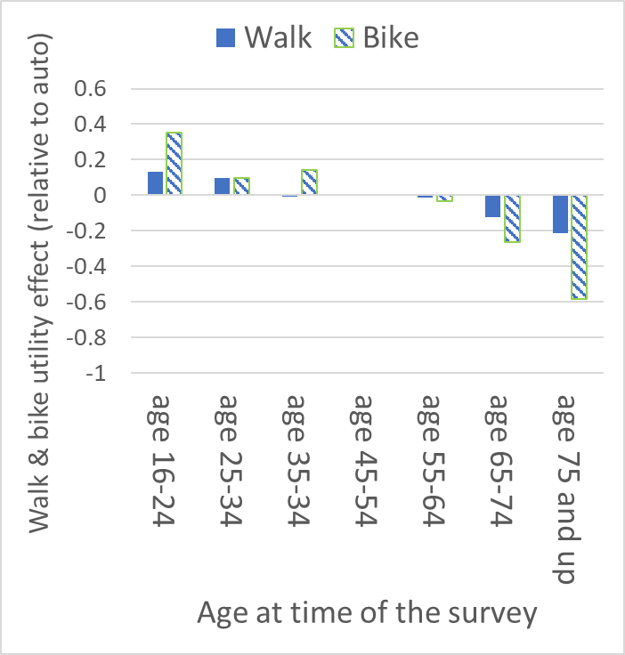
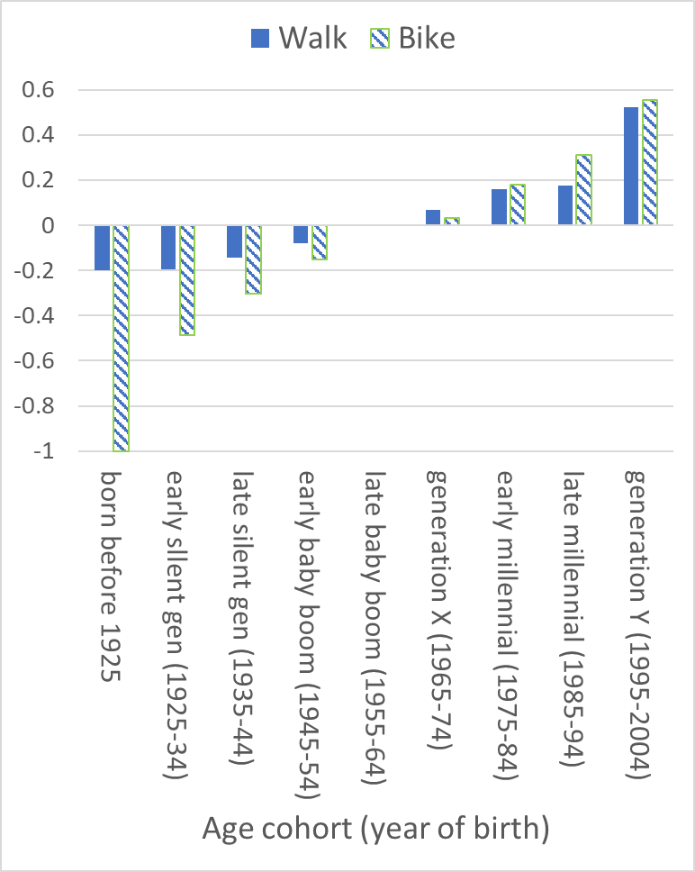

Age group and Generation coefficients from an adult non-work trip mode choice model

Slide 7
NEW for this presentation: an analysis of vehicle-miles traveled (VMT) by Adults over time
Previous research: McDonald, N. (2015). " Are Millennials Really the “Go-Nowhere” Generation?" Journal of the American Planning Association. (Used 1995, 2001, 2007 NHTS.)
RSG, Coogan, M., RAND Corp., Nelson/Nygaard. (2017). “NCHRP 08-36, Task 132. Understanding Changes in Youth Mobility”.
Updated method: Added data from 2017 and 2022 NHTS. Extended the focus beyond Millennials to all adults.
Again, controlled for income, race/ethnicity, household lifecycle, employment status, vehicle availability and residence area type, as well as year-specific effects

Slide 8
NEW for this presentation: an analysis of vehicle-miles traveled (VMT) by Adults over time. What are the trends behind the aggregate numbers?

Slide 9
Modeling approach: Log-Linear regression at the person-day level
The dependent variable is LN(vehicle-miles as a driver on the travel day + 1.0). The independent variables are:
Age group
Age cohort
Worker status
Gender by presence
and age of children
Household size
HH vehicle availability
Log of HH income (2025 $)
Race and ethnicity (not significant)
Log of Census block group population density
Non-MSA area
Day of the week
Month of the year
Proxy data bias
Residual constant for each survey year (not very large)

Slide 10
Generational effects in the opposite direction as for walk and bike in the previous example

Slide 11
AGE EFFECTS mostly disappear when age cohort effects are removed- they are confounded
The model fit also goes down very significantly..
R-squared 0.263 vs 0.247

Slide 12
Longitudinal data can also indicate shifts in other effects – GENDER Differences becoming less important than household lifecycle, with shift mainly occurring between 2001 and 2009 surveys

Slide 13
Conclusions
Ageing effects are confounded with age cohort (generation) effects in cross-sectional data.
Longitudinal data are needed to “untangle” the effects.
Each generation appears to drive somewhat less and walk and bike somewhat more than the generation it replaces, all else equal.
More frequent and consistent national travel surveys (like those in several other countries) would improve such analysis
It is particularly important for longer-term forecasting models when shifts in the future age profile are expected. (This is the case for the models used for most regional transportation plans.)
Assumptions needed for new adults (e.g. Gen Alpha the same as Gen Z)

Slide 14
THANK YOU
Mark Bradley
MarkB@BlueDoorSR.com

